Slide 1
Stroke EDA
File created on: 4/6/21 9:29:49 PM CDT

Slide 2
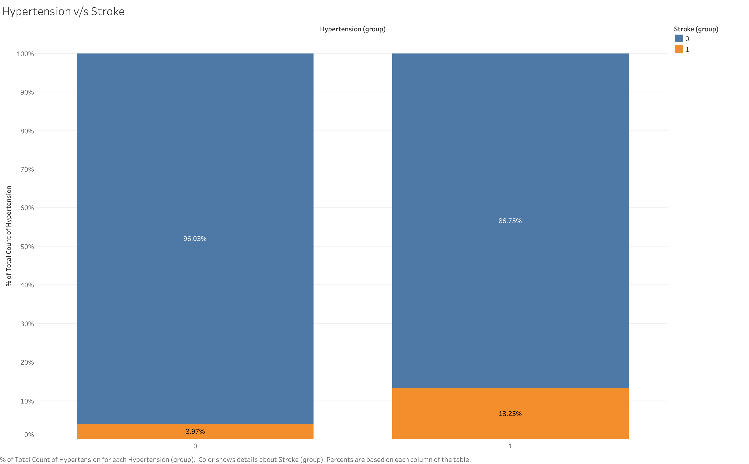

Slide 3
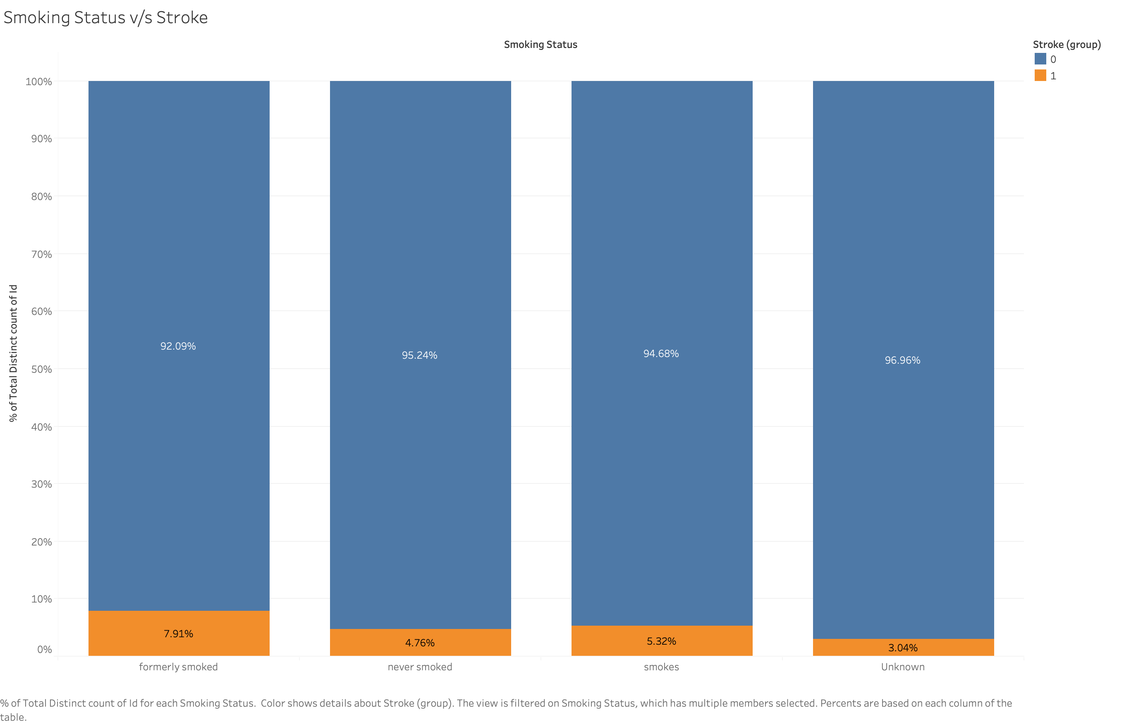

Slide 4
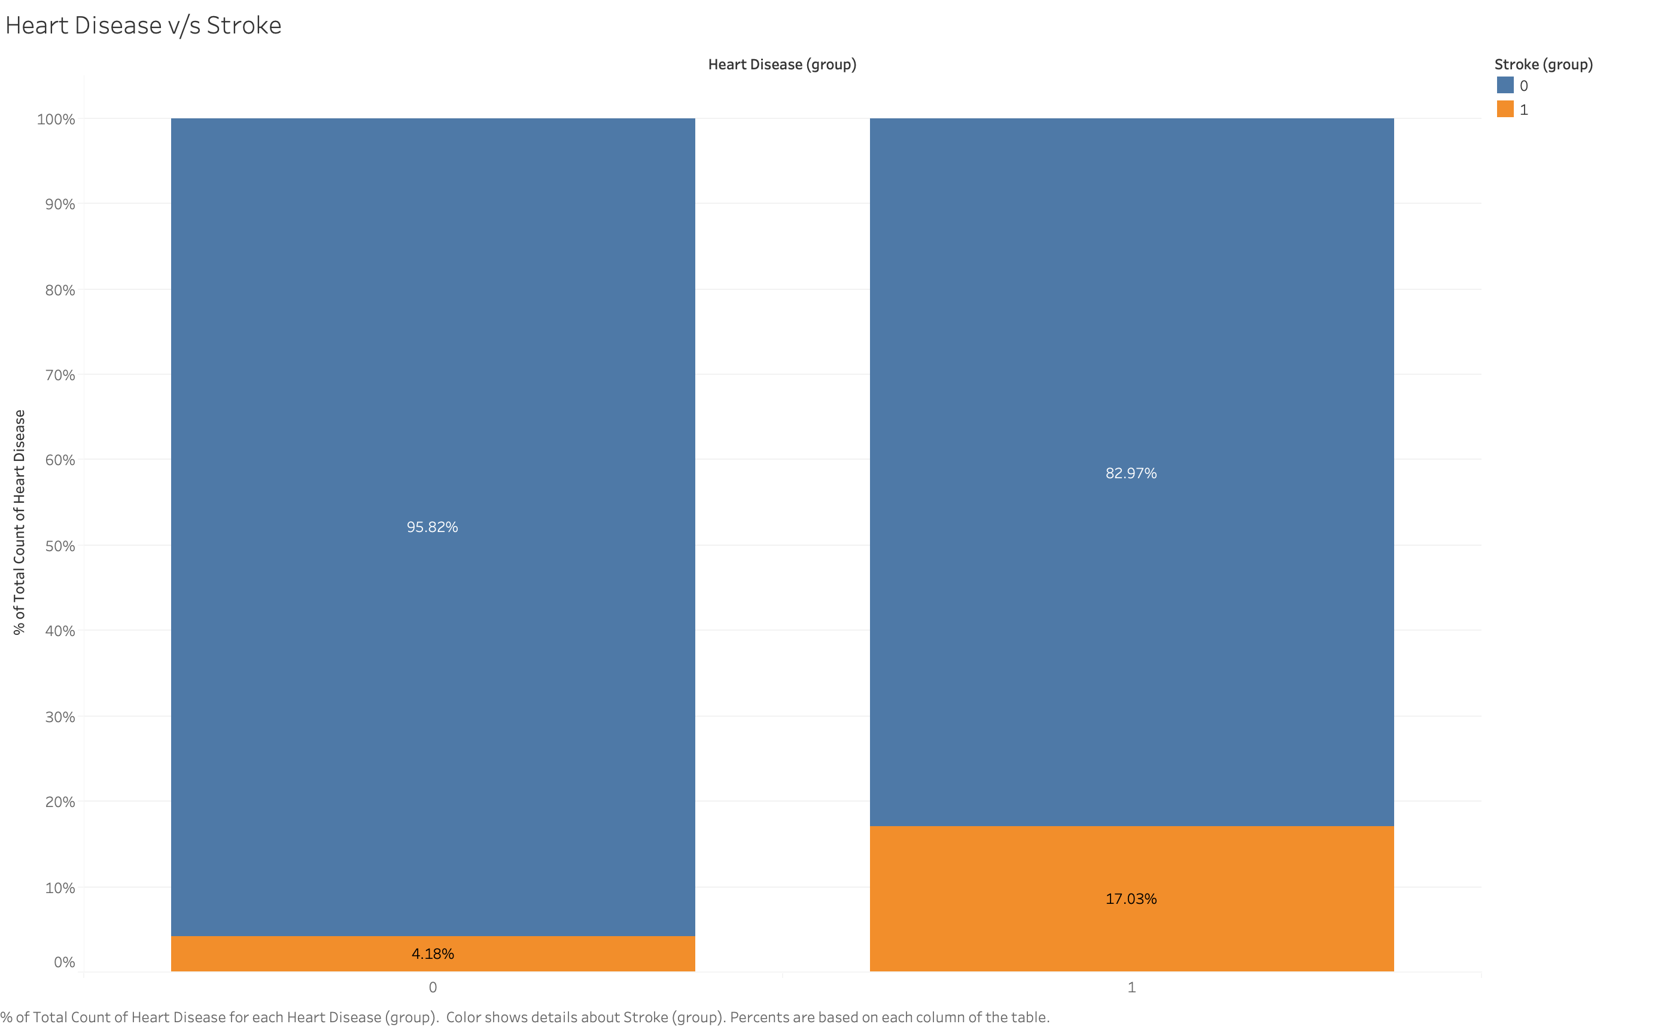

Slide 5
